Slide 1
Logistic Regression

Slide 2
Classification examples
Email: Spam / Not Spam?
Online Transaction: Fraudulent (Yes/No)?
Tumor: Malignant / Benign

Slide 3

Classification examples
Email: Spam / Not Spam?
Online Transaction: Fraudulent (Yes/No)?
Tumor: Malignant / Benign
$$y ∈ \left\{0, 1\right\}$$

Slide 4

Classification examples
Email: Spam / Not Spam?
Online Transaction: Fraudulent (Yes/No)?
Tumor: Malignant / Benign
0: Negative Class (e.g., benign tumor)
$$y ∈ \left\{0, 1\right\}$$

Slide 5

Classification examples
Email: Spam / Not Spam?
Online Transaction: Fraudulent (Yes/No)?
Tumor: Malignant / Benign
0: Negative Class (e.g., benign tumor)
1: Positive Class (e.g., malignant tumor)
$$y ∈ \left\{0, 1\right\}$$

Slide 6

Classification examples
Email: Spam / Not Spam?
Online Transaction: Fraudulent (Yes/No)?
Tumor: Malignant / Benign
0: Negative Class (e.g., benign tumor)
1: Positive Class (e.g., malignant tumor)
$$y ∈ \left\{0, 1\right\}$$
$$y ∈ \left\{0, 1, 2, 3\right\}$$

Slide 7
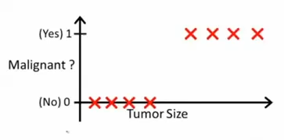

Slide 8
How about making a model with this
data using LINEAR REGRESSION?

Slide 9

$$h_{θ}\left(x\right)=θ^{T}x$$

Slide 10
$$h_{θ}\left(x\right)=θ^{T}x$$

Slide 11

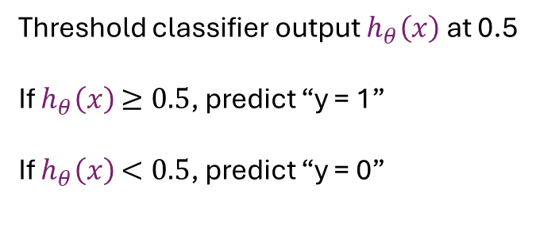
$$h_{θ}\left(x\right)=θ^{T}x$$
$$h_{θ}\left(x\right)=θ^{T}x$$
Threshold classifier output $h_{θ}\left(x\right)$ at 0.5
If $h_{θ}\left(x\right)$ $≥0.5$, predict “y = 1”
If $h_{θ}\left(x\right)$ $<0.5$, predict “y = 0”

Slide 12

$$h_{θ}\left(x\right)=θ^{T}x$$
$$h_{θ}\left(x\right)=θ^{T}x$$
Threshold classifier output $h_{θ}\left(x\right)$ at 0.5
If $h_{θ}\left(x\right)$ $≥0.5$, predict “y = 1”
If $h_{θ}\left(x\right)$ $<0.5$, predict “y = 0”

Slide 13
$$h_{θ}\left(x\right)=θ^{T}x$$
0.5
$$h_{θ}\left(x\right)=θ^{T}x$$
Threshold classifier output $h_{θ}\left(x\right)$ at 0.5
If $h_{θ}\left(x\right)$ $≥0.5$, predict “y = 1”
If $h_{θ}\left(x\right)$ $<0.5$, predict “y = 0”

Slide 14
$$h_{θ}\left(x\right)=θ^{T}x$$
0.5
-ve
+ve
$$h_{θ}\left(x\right)=θ^{T}x$$
Threshold classifier output $h_{θ}\left(x\right)$ at 0.5
If $h_{θ}\left(x\right)$ $≥0.5$, predict “y = 1”
If $h_{θ}\left(x\right)$ $<0.5$, predict “y = 0”

Slide 15

$$h_{θ}\left(x\right)=θ^{T}x$$
$$×$$
0.5
-ve
+ve
Tumor size
$$h_{θ}\left(x\right)=θ^{T}x$$
Threshold classifier output $h_{θ}\left(x\right)$ at 0.5
If $h_{θ}\left(x\right)$ $≥0.5$, predict “y = 1”
If $h_{θ}\left(x\right)$ $<0.5$, predict “y = 0”

Slide 16
$$h_{θ}\left(x\right)=θ^{T}x$$
$$×$$
0.5
-ve
+ve
Tumor size
$$h_{θ}\left(x\right)=θ^{T}x$$
Threshold classifier output $h_{θ}\left(x\right)$ at 0.5
If $h_{θ}\left(x\right)$ $≥0.5$, predict “y = 1”
If $h_{θ}\left(x\right)$ $<0.5$, predict “y = 0”

Slide 17
$$h_{θ}\left(x\right)=θ^{T}x$$
$$×$$
0.5
-ve
+ve
Tumor size
$$h_{θ}\left(x\right)=θ^{T}x$$
Threshold classifier output $h_{θ}\left(x\right)$ at 0.5
If $h_{θ}\left(x\right)$ $≥0.5$, predict “y = 1”
If $h_{θ}\left(x\right)$ $<0.5$, predict “y = 0”

Slide 18
$$h_{θ}\left(x\right)=θ^{T}x$$
$$×$$
0.5
-ve
+ve
Tumor size
$$h_{θ}\left(x\right)=θ^{T}x$$
Threshold classifier output $h_{θ}\left(x\right)$ at 0.5
If $h_{θ}\left(x\right)$ $≥0.5$, predict “y = 1”
If $h_{θ}\left(x\right)$ $<0.5$, predict “y = 0”

Slide 19
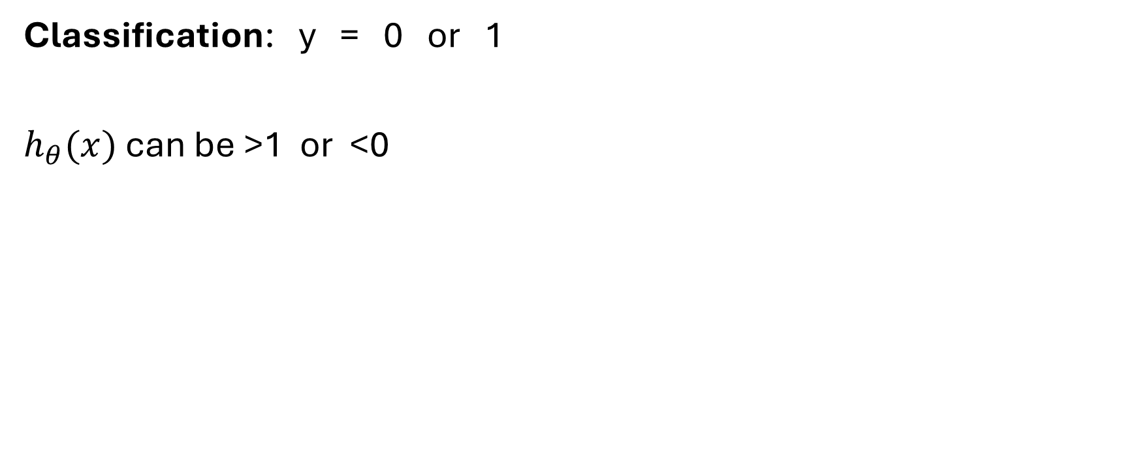
Classification: y = 0 or 1
$h_{θ}(x)$ can be >1 or <0

Slide 20
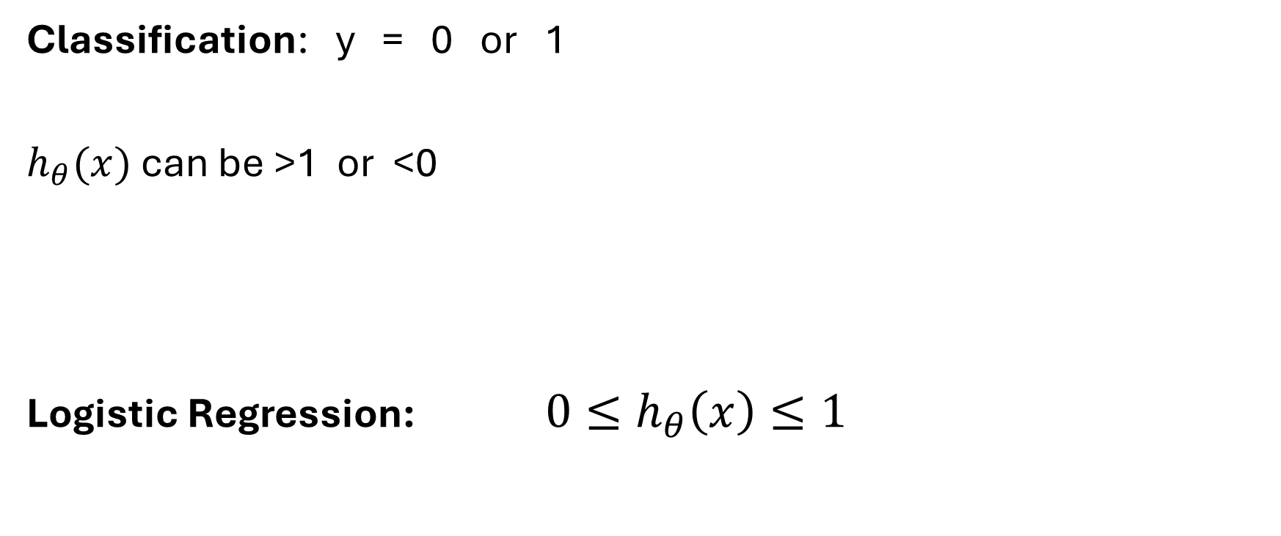
Classification: y = 0 or 1
$h_{θ}(x)$ can be >1 or <0
Logistic Regression: ${ 0≤h}_{θ}\left(x\right)≤1$

Slide 21
Classification: y = 0 or 1
$h_{θ}(x)$ can be >1 or <0
Logistic Regression: ${ 0≤h}_{θ}\left(x\right)≤1$
Actually CLASSIFICATION algorithm and NOT REGRESSION

Slide 22
Logistic Regression
Hypothesis Representation

Slide 23
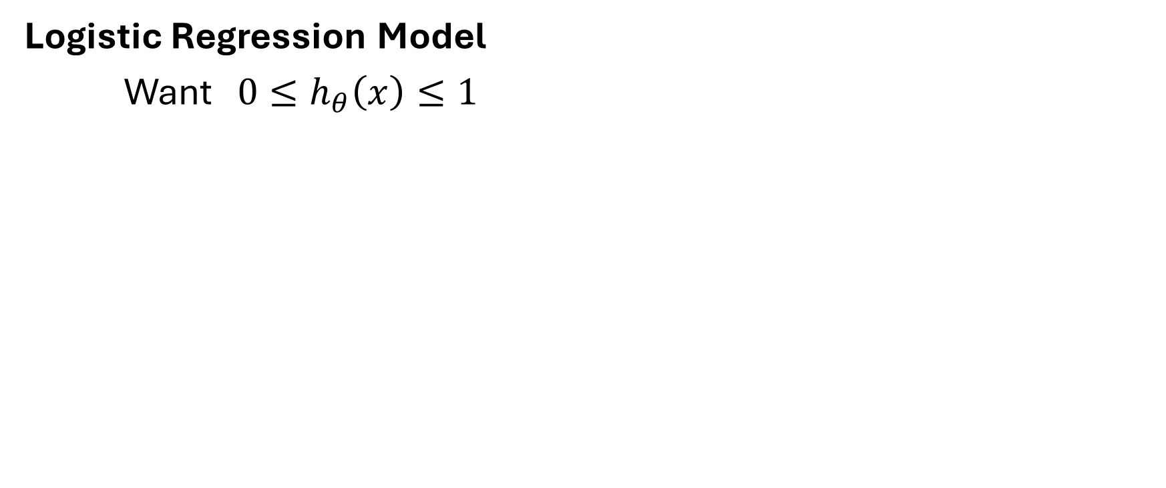
Logistic Regression Model
Want ${ 0≤h}_{θ}\left(x\right)≤1$

Slide 24
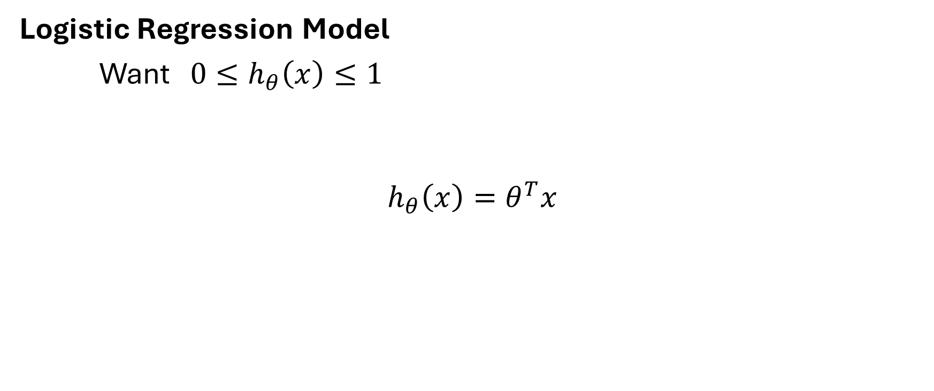
Logistic Regression Model
Want ${ 0≤h}_{θ}\left(x\right)≤1$
$$h_{θ}\left(x\right)=θ^{T}x$$
Linear Regression

Slide 25
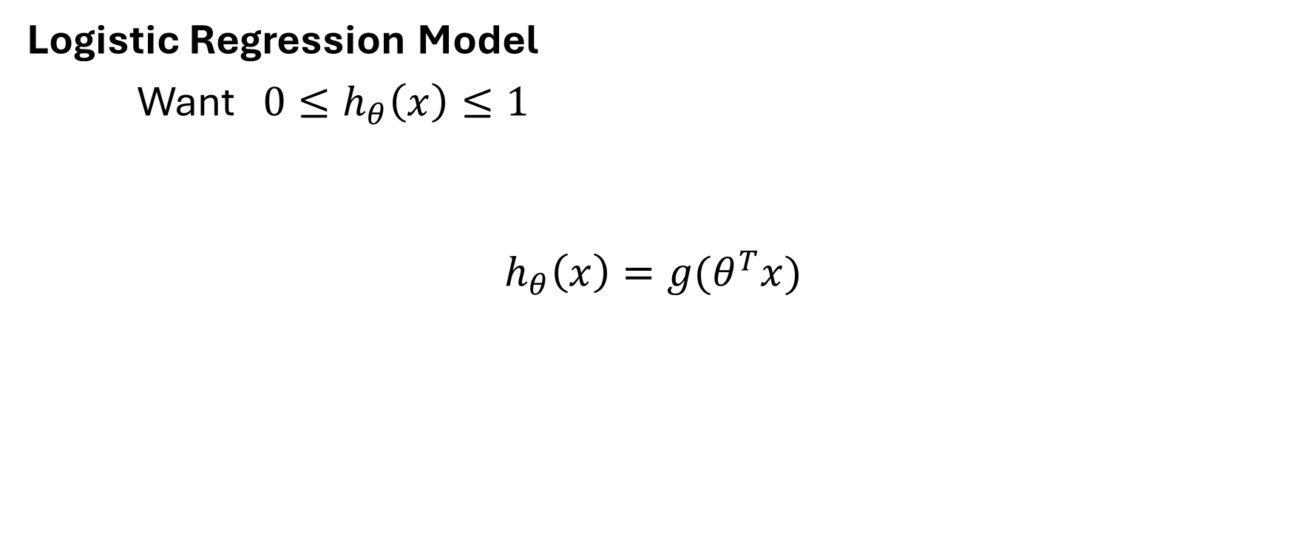
Logistic Regression Model
Want ${ 0≤h}_{θ}\left(x\right)≤1$
$$h_{θ}\left(x\right)={g(θ}^{T}x)$$
Logistic Regression

Slide 26
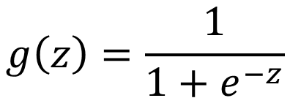
Logistic Regression Model
Want ${ 0≤h}_{θ}\left(x\right)≤1$
$$h_{θ}\left(x\right)={g(θ}^{T}x)$$
Logistic Regression
$$g\left(z\right)=\frac{1}{1+e^{−z}}$$

Slide 27
Logistic Regression Model
Want ${ 0≤h}_{θ}\left(x\right)≤1$
$$h_{θ}\left(x\right)={g(θ}^{T}x)$$
Logistic Regression
$$g\left(z\right)=\frac{1}{1+e^{−z}}$$
Sigmoid Function
Logistic Function

Slide 28
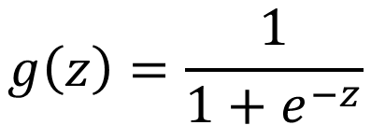
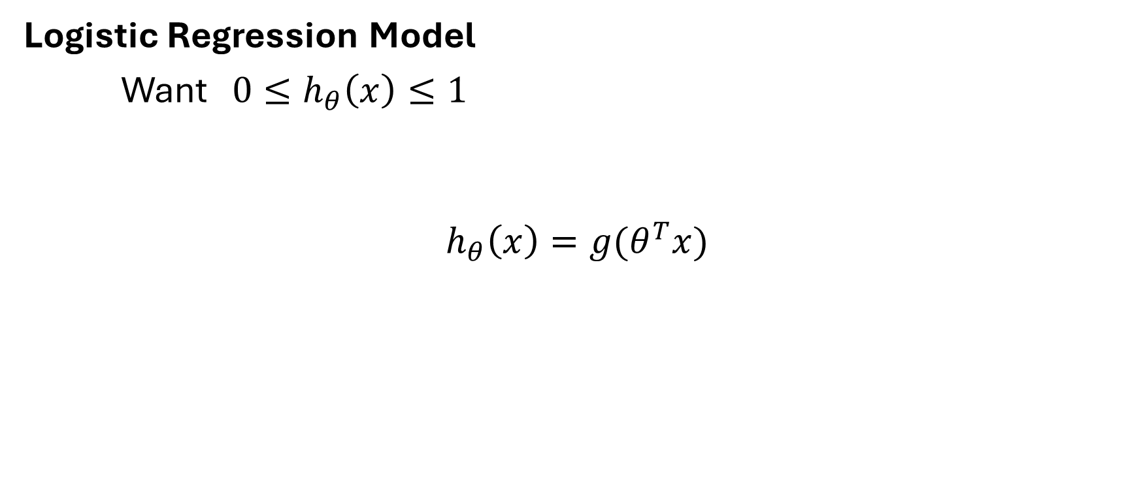
Logistic Regression Model
Want ${ 0≤h}_{θ}\left(x\right)≤1$
$$h_{θ}\left(x\right)={g(θ}^{T}x)$$
Logistic Regression
$$g\left(z\right)=\frac{1}{1+e^{−z}}$$
Sigmoid Function
Logistic Function

Slide 29
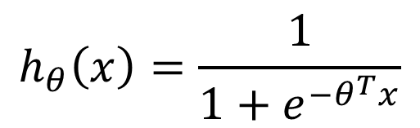
$$h_{θ}\left(x\right)=\frac{1}{1+e^{−θ^{T}x}}$$
Logistic Regression Model
Want ${ 0≤h}_{θ}\left(x\right)≤1$
$$h_{θ}\left(x\right)={g(θ}^{T}x)$$
Logistic Regression
$$g\left(z\right)=\frac{1}{1+e^{−z}}$$
Sigmoid Function
Logistic Function

Slide 30
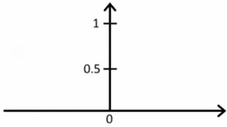

$$h_{θ}\left(x\right)=\frac{1}{1+e^{−θ^{T}x}}$$
Logistic Regression Model
Want ${ 0≤h}_{θ}\left(x\right)≤1$
$$h_{θ}\left(x\right)={g(θ}^{T}x)$$
Logistic Regression
$$g\left(z\right)=\frac{1}{1+e^{−z}}$$
Sigmoid Function
Logistic Function

Slide 31
Interpretation of Hypothesis Output

Slide 32
Interpretation of Hypothesis Output
${ h}_{θ}\left(x\right)$ = estimated probability that y=1 on input x

Slide 33
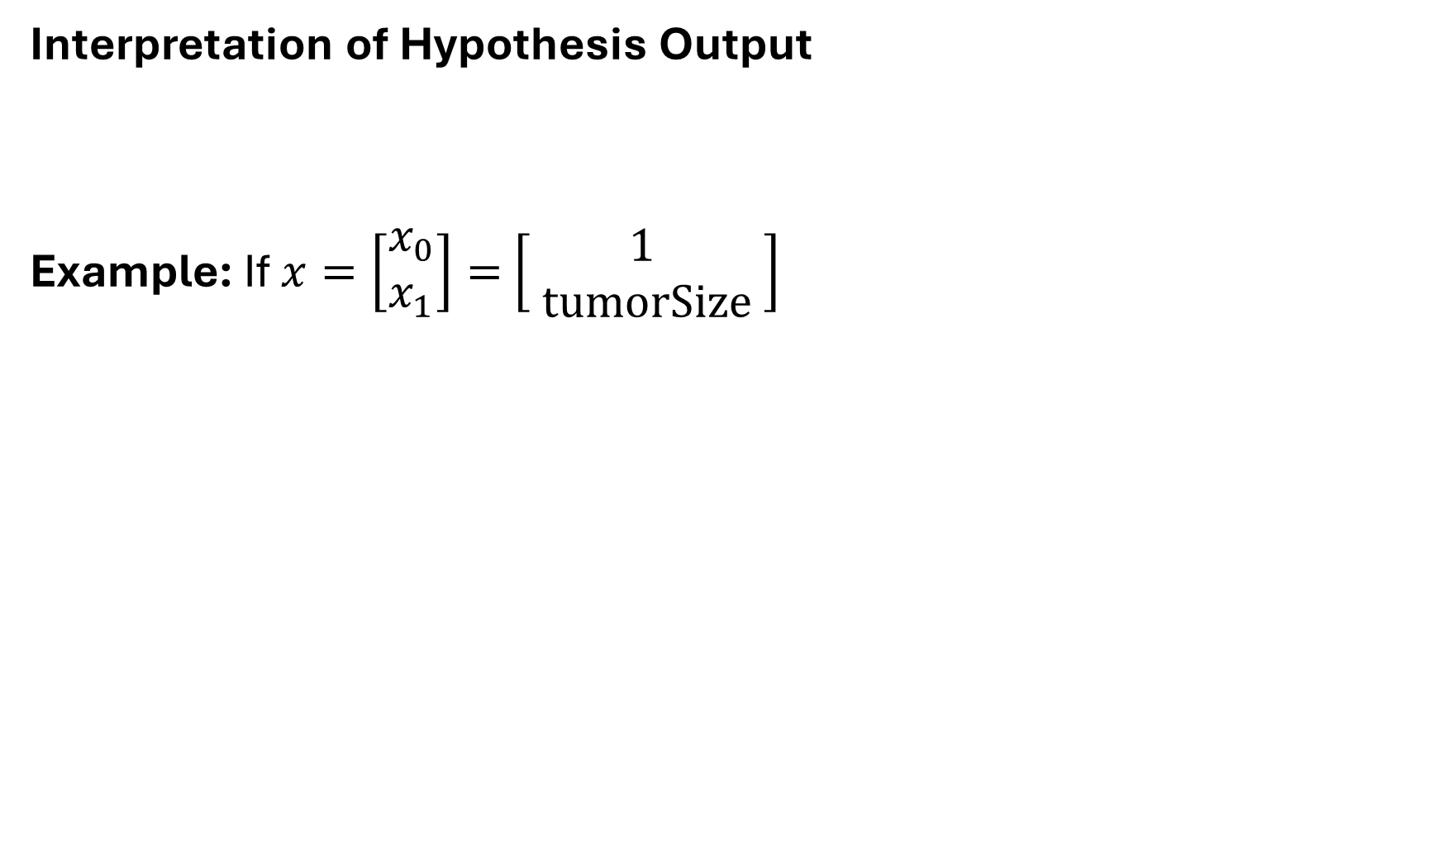
Interpretation of Hypothesis Output
Example: If $x=\left[\begin{aligned}x_{0} \\ x_{1}\end{aligned}\right]=$ $\left[\begin{aligned}1 \\ tumorSize\end{aligned} \right]$
${ h}_{θ}\left(x\right)$ = estimated probability that y=1 on input x

Slide 34
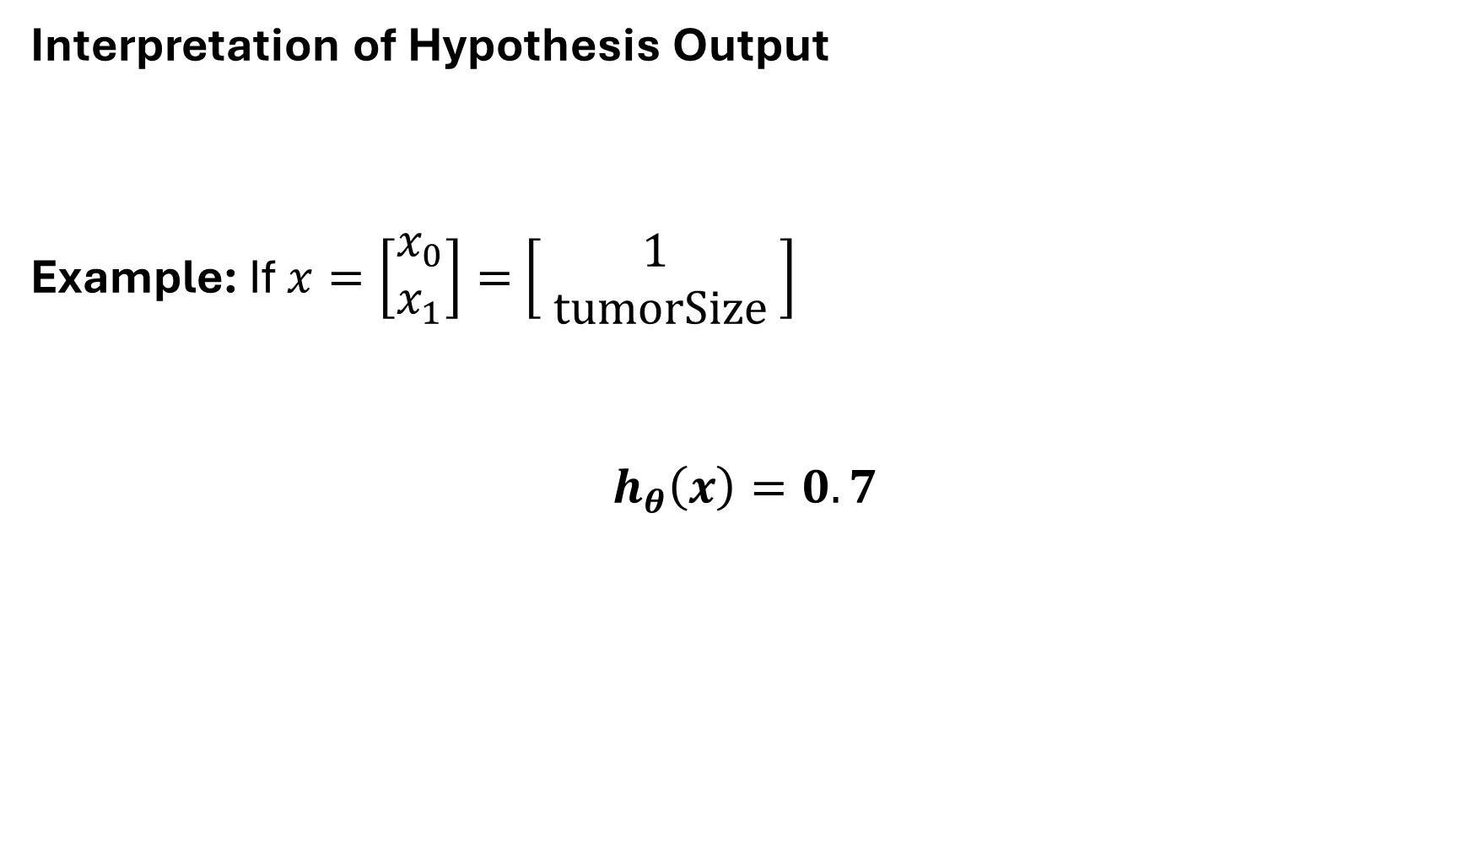
Interpretation of Hypothesis Output
Example: If $x=\left[\begin{aligned}x_{0} \\ x_{1}\end{aligned}\right]=$ $\left[\begin{aligned}1 \\ tumorSize\end{aligned} \right]$
$$h_{θ}\left(x\right)=0.7$$
${ h}_{θ}\left(x\right)$ = estimated probability that y=1 on input x

Slide 35
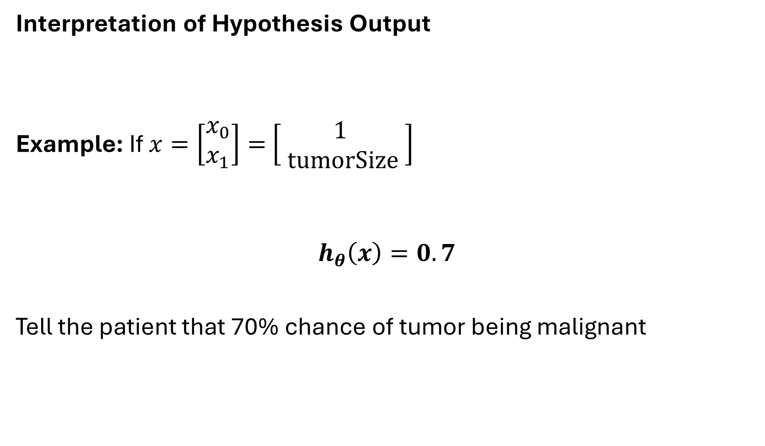
Interpretation of Hypothesis Output
Example: If $x=\left[\begin{aligned}x_{0} \\ x_{1}\end{aligned}\right]=$ $\left[\begin{aligned}1 \\ tumorSize\end{aligned} \right]$
$$h_{θ}\left(x\right)=0.7$$
Tell the patient that 70% chance of tumor being malignant
${ h}_{θ}\left(x\right)$ = estimated probability that y=1 on input x

Slide 36
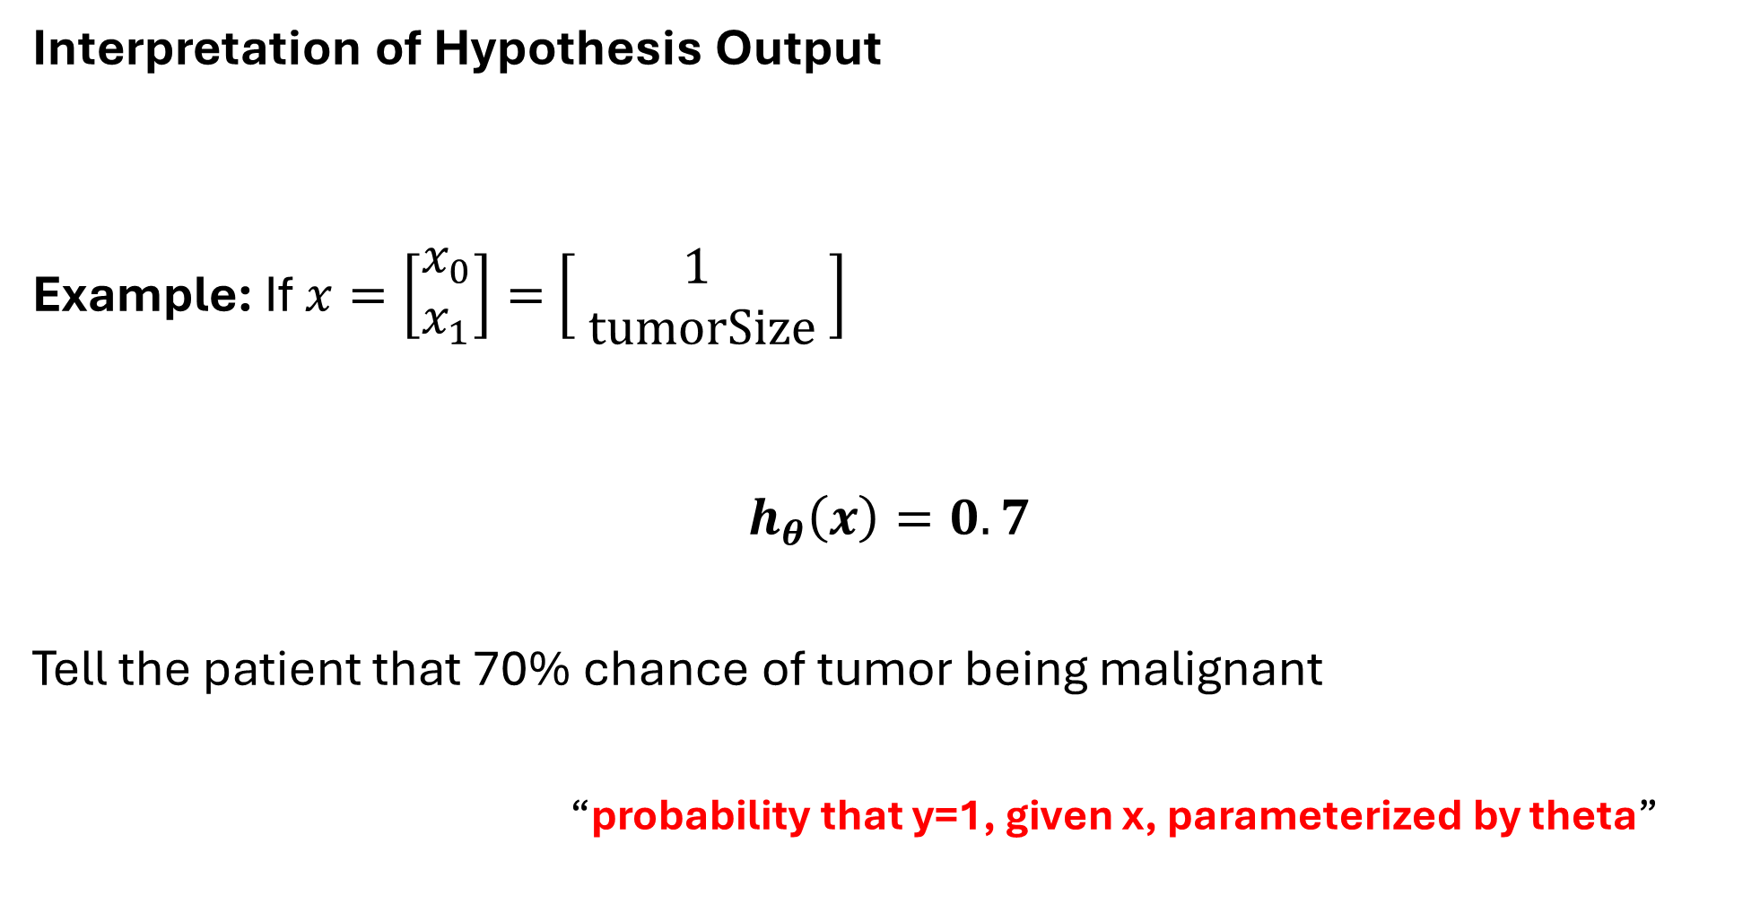

Interpretation of Hypothesis Output
Example: If $x=\left[\begin{aligned}x_{0} \\ x_{1}\end{aligned}\right]=$ $\left[\begin{aligned}1 \\ tumorSize\end{aligned} \right]$
$$h_{θ}\left(x\right)=0.7$$
Tell the patient that 70% chance of tumor being malignant
“probability that y=1, given x, parameterized by theta”
${ h}_{θ}\left(x\right)$ = estimated probability that y=1 on input x
$$h_{θ}\left(x\right)=p(y=1|x ;θ)$$

Slide 37
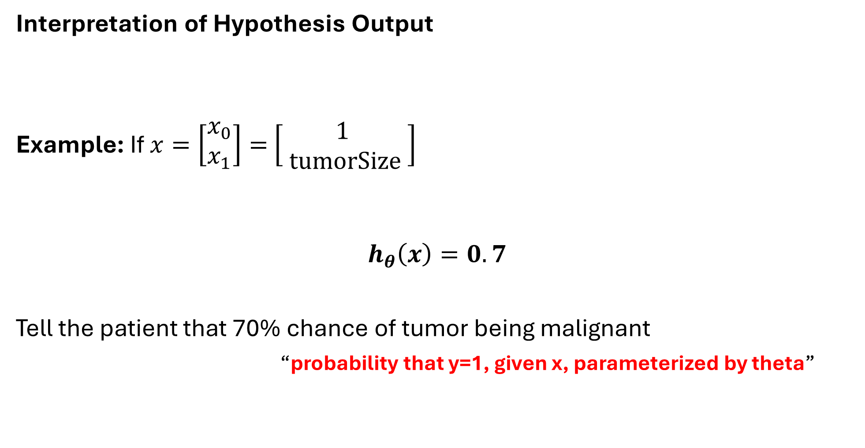

Interpretation of Hypothesis Output
Example: If $x=\left[\begin{aligned}x_{0} \\ x_{1}\end{aligned}\right]=$ $\left[\begin{aligned}1 \\ tumorSize\end{aligned} \right]$
$$h_{θ}\left(x\right)=0.7$$
Tell the patient that 70% chance of tumor being malignant
“probability that y=1, given x, parameterized by theta”
${ h}_{θ}\left(x\right)$ = estimated probability that y=1 on input x
$$h_{θ}\left(x\right)=p(y=1|x ;θ)$$
$$P\left(y=0 | x,θ\right)+P\left(y=1 | x,θ\right)=1$$

Slide 38
Interpretation of Hypothesis Output
Example: If $x=\left[\begin{aligned}x_{0} \\ x_{1}\end{aligned}\right]=$ $\left[\begin{aligned}1 \\ tumorSize\end{aligned} \right]$
$$h_{θ}\left(x\right)=0.7$$
Tell the patient that 70% chance of tumor being malignant
“probability that y=1, given x, parameterized by theta”
${ h}_{θ}\left(x\right)$ = estimated probability that y=1 on input x
$$h_{θ}\left(x\right)=p(y=1|x ;θ)$$
$$P\left(y=0 | x,θ\right)+P\left(y=1 | x,θ\right)=1$$
$$P\left(y=0 | x,θ\right)=1−P\left(y=1 | x,θ\right)$$

Slide 39
Logistic Regression
Decision Boundary

Slide 40
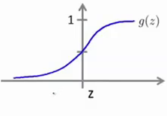
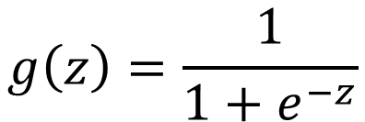

Logistic Regression
$$h_{θ}\left(x\right)={g(θ}^{T}x)$$
$$g\left(z\right)=\frac{1}{1+e^{−z}}$$

Slide 41
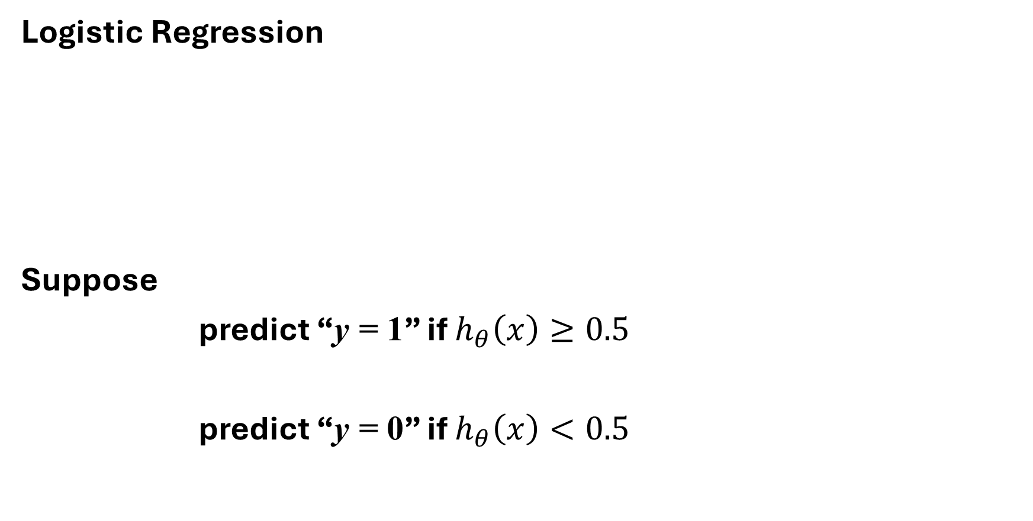
Logistic Regression
Suppose
predict “y = 1” if $h_{θ}\left(x\right)≥0.5$
predict “y = 0” if $h_{θ}\left(x\right)<0.5$
$$h_{θ}\left(x\right)={g(θ}^{T}x)$$
$$g\left(z\right)=\frac{1}{1+e^{−z}}$$

Slide 42
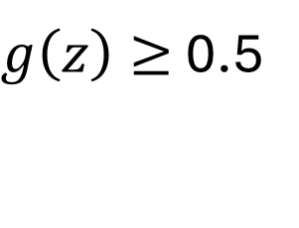
Logistic Regression
Suppose
predict “y = 1” if $h_{θ}\left(x\right)≥0.5$
predict “y = 0” if $h_{θ}\left(x\right)<0.5$
$$h_{θ}\left(x\right)={g(θ}^{T}x)$$
$$g\left(z\right)=\frac{1}{1+e^{−z}}$$
$g\left(z\right)≥$ 0.5

Slide 43
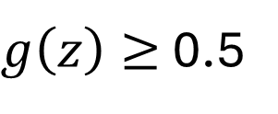
Logistic Regression
Suppose
predict “y = 1” if $h_{θ}\left(x\right)≥0.5$
predict “y = 0” if $h_{θ}\left(x\right)<0.5$
$$h_{θ}\left(x\right)={g(θ}^{T}x)$$
0.5
$$g\left(z\right)=\frac{1}{1+e^{−z}}$$
$g\left(z\right)≥$ 0.5

Slide 44
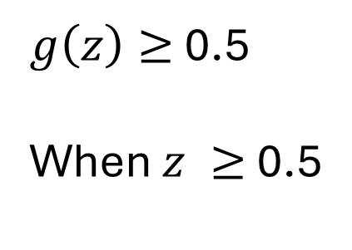
Logistic Regression
Suppose
predict “y = 1” if $h_{θ}\left(x\right)≥0.5$
predict “y = 0” if $h_{θ}\left(x\right)<0.5$
$$h_{θ}\left(x\right)={g(θ}^{T}x)$$
0.5
$$g\left(z\right)=\frac{1}{1+e^{−z}}$$
$g\left(z\right)≥$ 0.5
When $z ≥$ 0.5

Slide 45
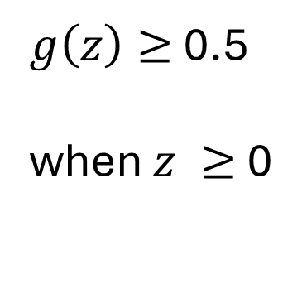

Logistic Regression
Suppose
predict “y = 1” if $h_{θ}\left(x\right)≥0.5$
predict “y = 0” if $h_{θ}\left(x\right)<0.5$
$$h_{θ}\left(x\right)={g(θ}^{T}x)$$
0.5
$$g\left(z\right)=\frac{1}{1+e^{−z}}$$
$g\left(z\right)≥$ 0.5
when $z ≥$ 0

Slide 46
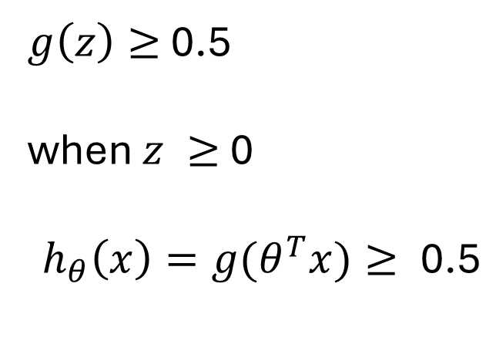
Logistic Regression
Suppose
predict “y = 1” if $h_{θ}\left(x\right)≥0.5$
predict “y = 0” if $h_{θ}\left(x\right)<0.5$
$$h_{θ}\left(x\right)={g(θ}^{T}x)$$
0.5
$$g\left(z\right)=\frac{1}{1+e^{−z}}$$
$g\left(z\right)≥$ 0.5
when $z ≥$ 0
$$h_{θ}\left(x\right)={g(θ}^{T}x)≥\text{ 0.5}$$

Slide 47
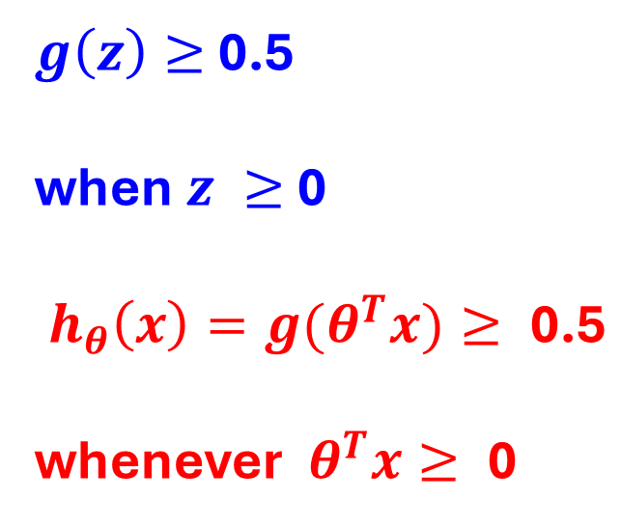
Logistic Regression
Suppose
predict “y = 1” if $h_{θ}\left(x\right)≥0.5$
predict “y = 0” if $h_{θ}\left(x\right)<0.5$
$$h_{θ}\left(x\right)={g(θ}^{T}x)$$
0.5
$$g\left(z\right)=\frac{1}{1+e^{−z}}$$
$g\left(z\right)≥$ 0.5
when $z ≥$ 0
$$h_{θ}\left(x\right)={g(θ}^{T}x)≥\text{ 0.5}$$
whenever${ θ}^{T}x≥\text{ 0}$

Slide 48

Logistic Regression
Suppose
predict “y = 1” if $h_{θ}\left(x\right)≥0.5$
predict “y = 0” if $h_{θ}\left(x\right)<0.5$
$$h_{θ}\left(x\right)={g(θ}^{T}x)$$
0.5
$$g\left(z\right)=\frac{1}{1+e^{−z}}$$
$${ θ}^{T}x≥\text{ 0}$$
$g\left(z\right)≥$ 0.5
when $z ≥$ 0
$$h_{θ}\left(x\right)={g(θ}^{T}x)≥\text{ 0.5}$$
whenever${ θ}^{T}x≥\text{ 0}$

Slide 49

Logistic Regression
Suppose
predict “y = 1” if $h_{θ}\left(x\right)≥0.5$
predict “y = 0” if $h_{θ}\left(x\right)<0.5$
$$h_{θ}\left(x\right)={g(θ}^{T}x)$$
0.5
$$g\left(z\right)=\frac{1}{1+e^{−z}}$$
$${ θ}^{T}x≥\text{ 0}$$
$g\left(z\right)≥$ 0.5
when $z ≥$ 0
$$h_{θ}\left(x\right)={g(θ}^{T}x)≥\text{ 0.5}$$
whenever${ θ}^{T}x≥\text{ 0}$

Slide 50

Logistic Regression
Suppose
predict “y = 1” if $h_{θ}\left(x\right)≥0.5$
predict “y = 0” if $h_{θ}\left(x\right)<0.5$
$$h_{θ}\left(x\right)={g(θ}^{T}x)$$
0.5
$$g\left(z\right)=\frac{1}{1+e^{−z}}$$
$${ θ}^{T}x≥\text{ 0}$$
$g\left(z\right)≥$ 0.5
when $z ≥$ 0
$$h_{θ}\left(x\right)={g(θ}^{T}x)≥\text{ 0.5}$$
whenever${ θ}^{T}x≥\text{ 0}$
$${ θ}^{T}x<\text{ 0}$$

Slide 51
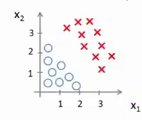
Decision Boundary

Slide 52
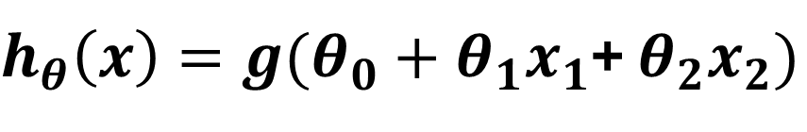
Decision Boundary
$h_{θ}\left(x\right)=g(θ_{0}+θ_{1}x_{1}$+ $θ_{2}x_{2})$

Slide 53
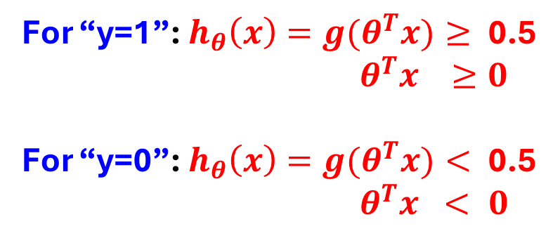
Decision Boundary
$h_{θ}\left(x\right)=g(θ_{0}+θ_{1}x_{1}$+ $θ_{2}x_{2})$
For “y=1”: $h_{θ}\left(x\right)={g(θ}^{T}x)≥\text{ 0.5}$
$θ^{T}x ≥0$
For “y=0”: $h_{θ}\left(x\right)={g(θ}^{T}x)<\text{ 0.5}$
${ θ}^{T}x < 0$

Slide 54
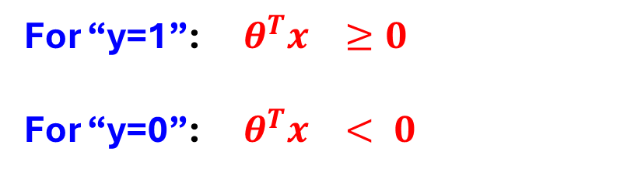
Decision Boundary
$h_{θ}\left(x\right)=g(θ_{0}+θ_{1}x_{1}$+ $θ_{2}x_{2})$
For “y=1”:$θ^{T}x ≥0$
For “y=0”:${ θ}^{T}x < 0$

Slide 55

For “y=1”:$θ^{T}x ≥0$
For “y=0”:${ θ}^{T}x < 0$
Decision Boundary
$h_{θ}\left(x\right)=g(θ_{0}+θ_{1}x_{1}$+ $θ_{2}x_{2})$
-3 1 1

Slide 56
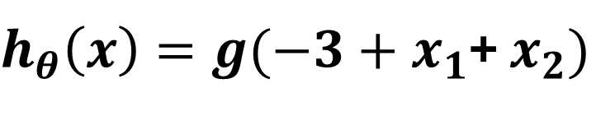
For “y=1”:$θ^{T}x ≥0$
For “y=0”:${ θ}^{T}x < 0$
Decision Boundary
$h_{θ}\left(x\right)=g(θ_{0}+θ_{1}x_{1}$+ $θ_{2}x_{2})$
-3 1 1
$h_{θ}\left(x\right)=g(−3+x_{1}$+ $x_{2})$

Slide 57

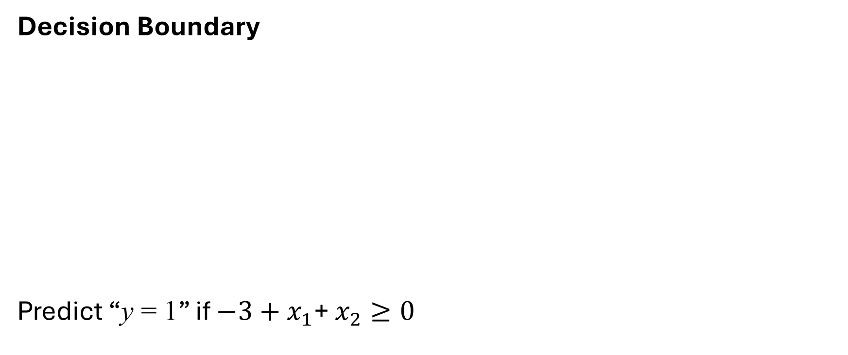
For “y=1”:$θ^{T}x ≥0$
For “y=0”:${ θ}^{T}x < 0$
Decision Boundary
Predict “y = 1” if $−3+x_{1}$+ $x_{2}≥0$
$h_{θ}\left(x\right)=g(θ_{0}+θ_{1}x_{1}$+ $θ_{2}x_{2})$
-3 1 1

Slide 58

For “y=1”:$θ^{T}x ≥0$
For “y=0”:${ θ}^{T}x < 0$
Decision Boundary
Predict “y = 1” if $−3+x_{1}$+ $x_{2}≥0$
$h_{θ}\left(x\right)=g(θ_{0}+θ_{1}x_{1}$+ $θ_{2}x_{2})$
-3 1 1
$$θ^{T}x$$

Slide 59

For “y=1”:$θ^{T}x ≥0$
For “y=0”:${ θ}^{T}x < 0$
Decision Boundary
Predict “y = 1” if $−3+x_{1}$+ $x_{2}≥0$
$h_{θ}\left(x\right)=g(θ_{0}+θ_{1}x_{1}$+ $θ_{2}x_{2})$
-3 1 1

Slide 60
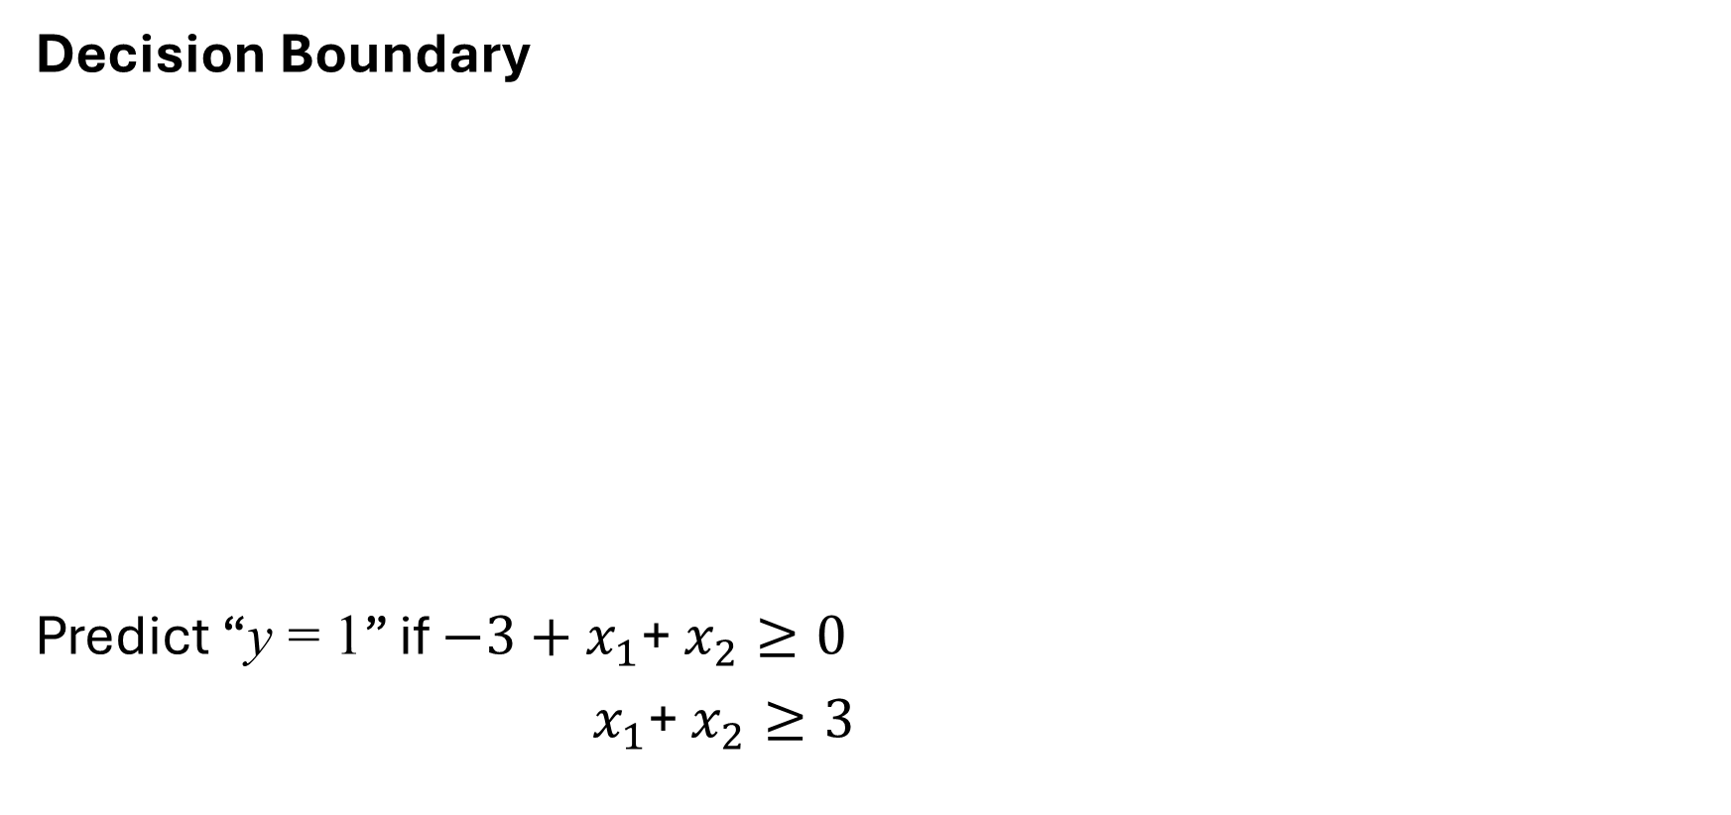
For “y=1”:$θ^{T}x ≥0$
For “y=0”:${ θ}^{T}x < 0$
Decision Boundary
Predict “y = 1” if $−3+x_{1}$+ $x_{2}≥0$
$x_{1}$+ $x_{2}≥3$
$h_{θ}\left(x\right)=g(θ_{0}+θ_{1}x_{1}$+ $θ_{2}x_{2})$
-3 1 1

Slide 61

For “y=1”:$θ^{T}x ≥0$
For “y=0”:${ θ}^{T}x < 0$
Decision Boundary
Predict “y = 1” if $−3+x_{1}$+ $x_{2}≥0$
$x_{1}$+ $x_{2}≥3$
$h_{θ}\left(x\right)=g(θ_{0}+θ_{1}x_{1}$+ $θ_{2}x_{2})$
-3 1 1

Slide 62
For “y=1”:$θ^{T}x ≥0$
For “y=0”:${ θ}^{T}x < 0$
Decision Boundary
Predict “y = 1” if $−3+x_{1}$+ $x_{2}≥0$
$x_{1}$+ $x_{2}≥3$
$h_{θ}\left(x\right)=g(θ_{0}+θ_{1}x_{1}$+ $θ_{2}x_{2})$
y = 1
-3 1 1

Slide 63
For “y=1”:$θ^{T}x ≥0$
For “y=0”:${ θ}^{T}x < 0$
Decision Boundary
Predict “y = 1” if $−3+x_{1}$+ $x_{2}≥0$
$x_{1}$+ $x_{2}≥3$
$h_{θ}\left(x\right)=g(θ_{0}+θ_{1}x_{1}$+ $θ_{2}x_{2})$
y = 1
-3 1 1
y = 0

Slide 64
For “y=1”:$θ^{T}x ≥0$
For “y=0”:${ θ}^{T}x < 0$
Decision Boundary
Predict “y = 1” if $−3+x_{1}$+ $x_{2}≥0$
$x_{1}$+ $x_{2}≥3$
$h_{θ}\left(x\right)=g(θ_{0}+θ_{1}x_{1}$+ $θ_{2}x_{2})$
y = 1
-3 1 1
y = 0
Decision Boundary

Slide 65
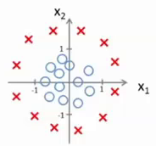
Non-linear Decision Boundary

Slide 66
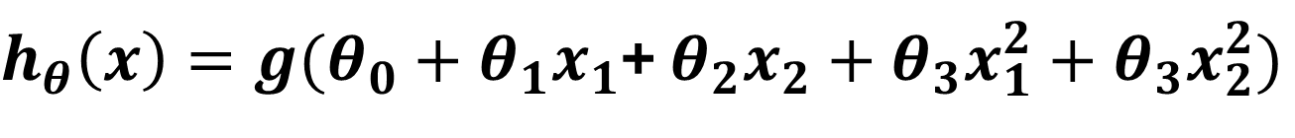
Non-linear Decision Boundary
$h_{θ}\left(x\right)=g(θ_{0}+θ_{1}x_{1}$+ $θ_{2}x_{2}+θ_{3}x_{1}^{2}+θ_{3}x_{2}^{2})$

Slide 67
Non-linear Decision Boundary
$h_{θ}\left(x\right)=g(θ_{0}+θ_{1}x_{1}$+ $θ_{2}x_{2}+θ_{3}x_{1}^{2}+θ_{3}x_{2}^{2})$
-1 0 0 1 1

Slide 68

Non-linear Decision Boundary
$h_{θ}\left(x\right)=g(θ_{0}+θ_{1}x_{1}$+ $θ_{2}x_{2}+θ_{3}x_{1}^{2}+θ_{3}x_{2}^{2})$
-1 0 0 1 1
Predict “y = 1” if $−1+x_{1}^{2}+x_{2}^{2}≥0$

Slide 69

Non-linear Decision Boundary
$h_{θ}\left(x\right)=g(θ_{0}+θ_{1}x_{1}$+ $θ_{2}x_{2}+θ_{3}x_{1}^{2}+θ_{3}x_{2}^{2})$
-1 0 0 1 1
Predict “y = 1” if $−1+x_{1}^{2}+x_{2}^{2}≥0$

Slide 70

Non-linear Decision Boundary
$h_{θ}\left(x\right)=g(θ_{0}+θ_{1}x_{1}$+ $θ_{2}x_{2}+θ_{3}x_{1}^{2}+θ_{3}x_{2}^{2})$
-1 0 0 1 1
Predict “y = 1” if $−1+x_{1}^{2}+x_{2}^{2}≥0$
$x_{1}^{2}+x_{2}^{2}≥1$

Slide 71
Non-linear Decision Boundary
Decision Boundary
$h_{θ}\left(x\right)=g(θ_{0}+θ_{1}x_{1}$+ $θ_{2}x_{2}+θ_{3}x_{1}^{2}+θ_{3}x_{2}^{2})$
-1 0 0 1 1
Predict “y = 1” if $−1+x_{1}^{2}+x_{2}^{2}≥0$
$x_{1}^{2}+x_{2}^{2}≥1$

Slide 72
Non-linear Decision Boundary
Decision Boundary
y = 1
$h_{θ}\left(x\right)=g(θ_{0}+θ_{1}x_{1}$+ $θ_{2}x_{2}+θ_{3}x_{1}^{2}+θ_{3}x_{2}^{2})$
y = 1
y = 0
-1 0 0 1 1
y = 1
y = 1
Predict “y = 1” if $−1+x_{1}^{2}+x_{2}^{2}≥0$
$x_{1}^{2}+x_{2}^{2}≥1$

Slide 73
Logistic Regression
Cost function

Slide 74
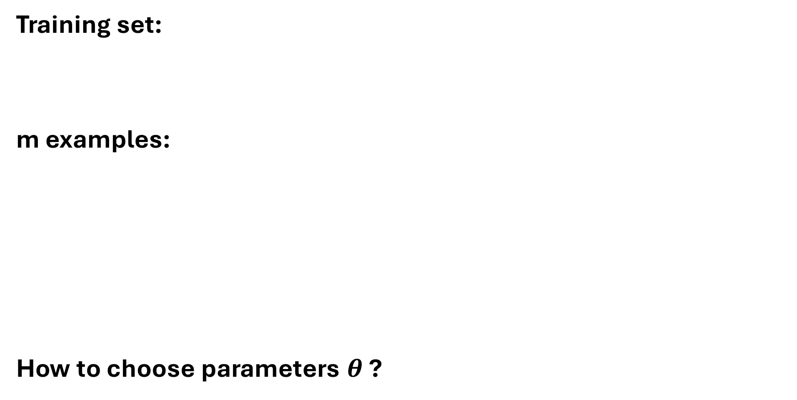
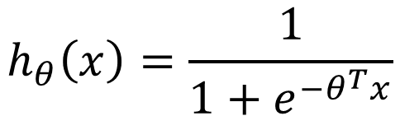
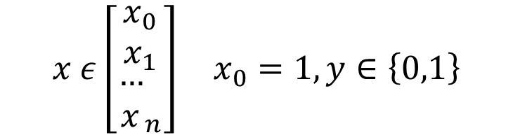
Training set:
m examples:
How to choose parameters $θ$ ?
$$\left\{\left(x^{(1)},y^{(1)}\right),\left(x^{(2)},y^{(2)}\right),…,\left(x^{(m)},y^{(m)}\right)\right\}$$
$$x ε\left[\begin{aligned}x_{0} \\ x_{1} \\ {\begin{aligned}… \\ x\end{aligned}}_{n}\end{aligned}\right] x_{0}=1,y∈\left\{0,1\right\}$$
$$h_{θ}\left(x\right)=\frac{1}{1+e^{−θ^{T}x}}$$

Slide 75
Cost function
Linear regression: ?

Slide 76
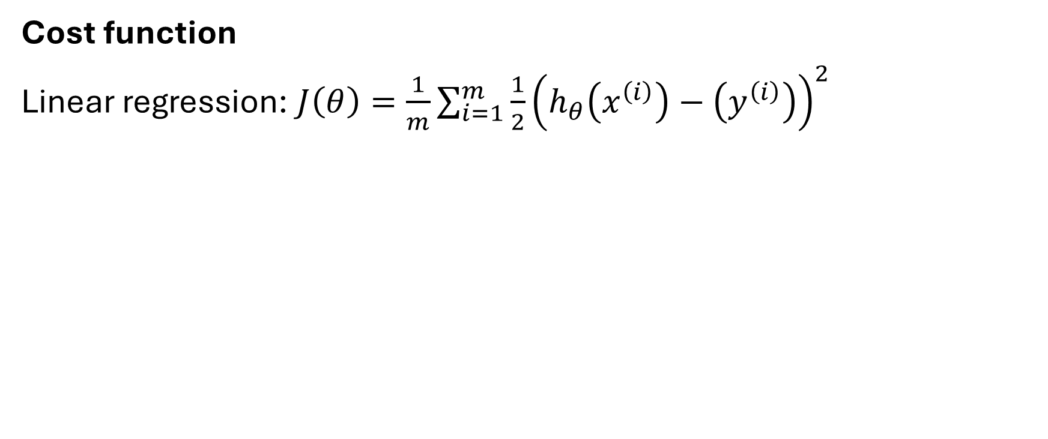
Cost function
Linear regression: $J\left(θ\right)=\frac{1}{m}\sum_{i=1}^{m}{\frac{1}{2}}{\left(h_{θ}\left(x^{\left(i\right)}\right)−\left(y^{\left(i\right)}\right)\right)}^{2}$

Slide 77
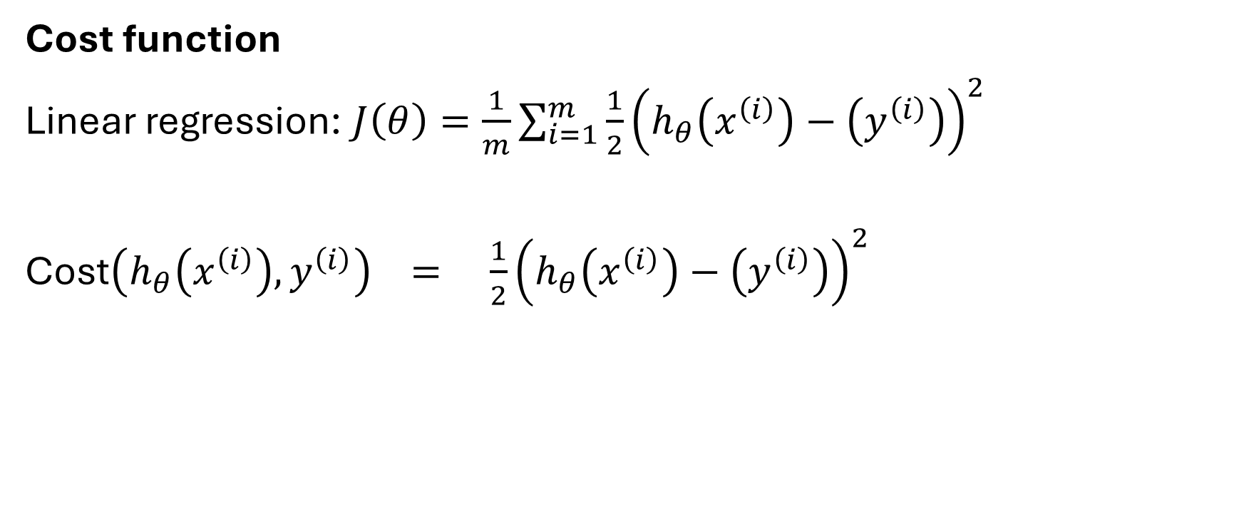
Cost function
Linear regression: $J\left(θ\right)=\frac{1}{m}\sum_{i=1}^{m}{\frac{1}{2}}{\left(h_{θ}\left(x^{\left(i\right)}\right)−\left(y^{\left(i\right)}\right)\right)}^{2}$
Cost$\left(h_{θ}\left(x^{\left(i\right)}\right),y^{\left(i\right)}\right) = \frac{1}{2}{\left(h_{θ}\left(x^{\left(i\right)}\right)−\left(y^{\left(i\right)}\right)\right)}^{2}$

Slide 78
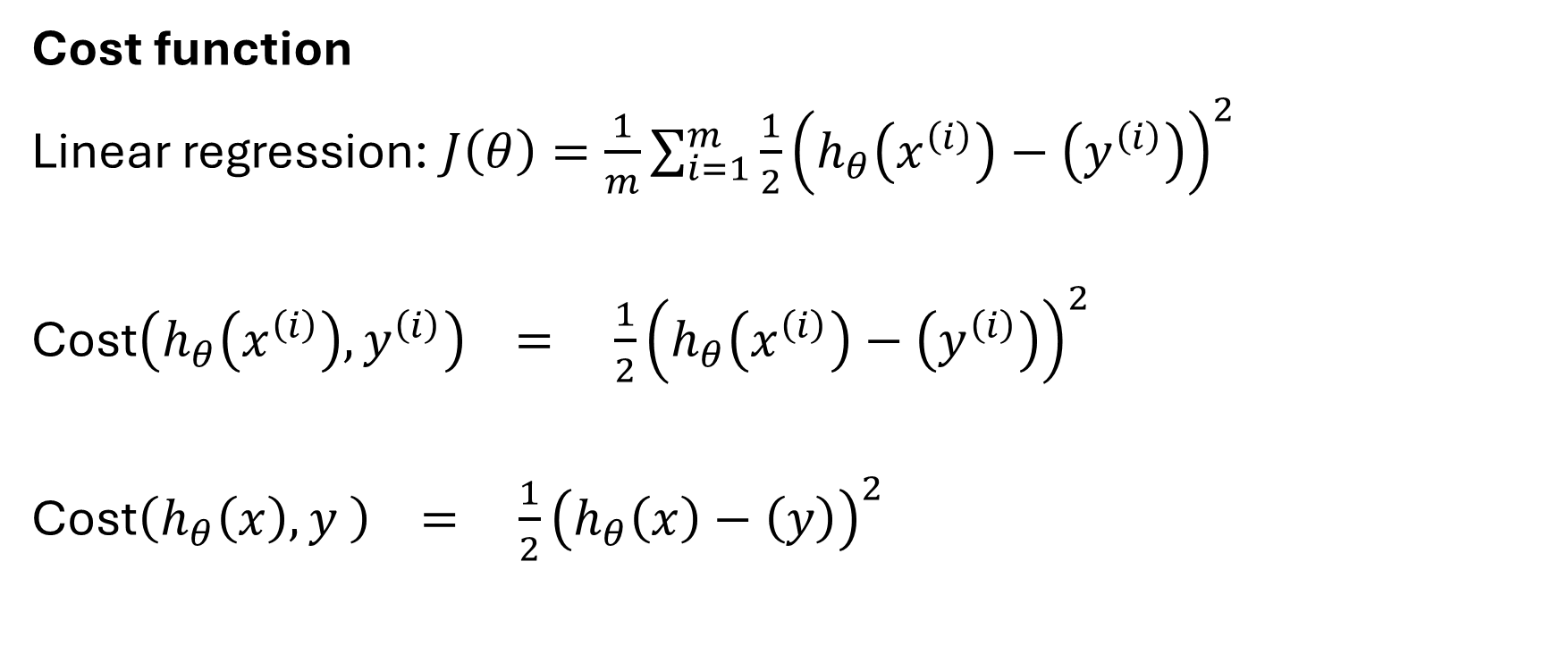
Cost function
Linear regression: $J\left(θ\right)=\frac{1}{m}\sum_{i=1}^{m}{\frac{1}{2}}{\left(h_{θ}\left(x^{\left(i\right)}\right)−\left(y^{\left(i\right)}\right)\right)}^{2}$
Cost$\left(h_{θ}\left(x^{\left(i\right)}\right),y^{\left(i\right)}\right) = \frac{1}{2}{\left(h_{θ}\left(x^{\left(i\right)}\right)−\left(y^{\left(i\right)}\right)\right)}^{2}$
Cost$\left(h_{θ}\left(x\right),y \right) = \frac{1}{2}{\left(h_{θ}\left(x\right)−\left(y\right)\right)}^{2}$

Slide 79
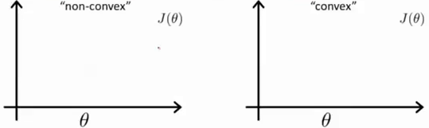
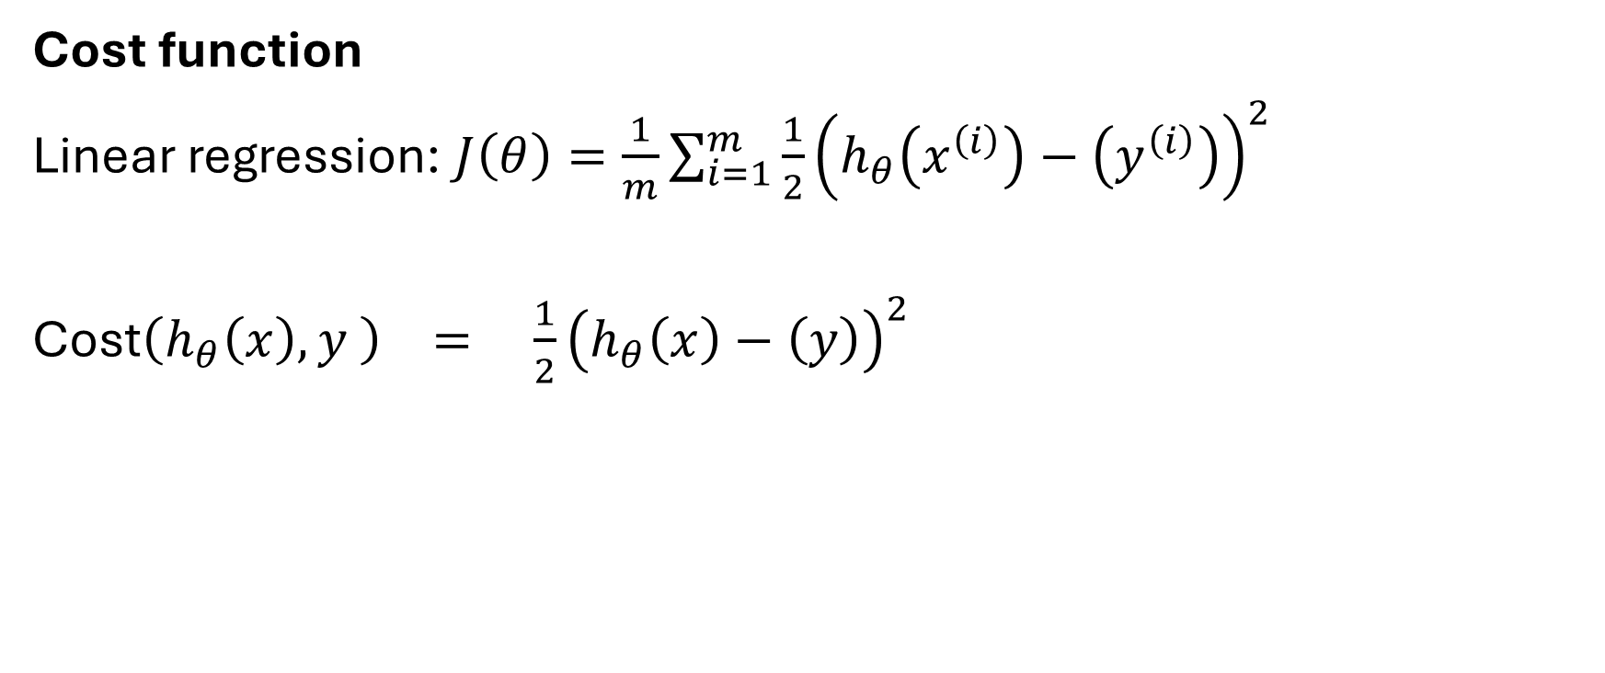
Cost function
Linear regression: $J\left(θ\right)=\frac{1}{m}\sum_{i=1}^{m}{\frac{1}{2}}{\left(h_{θ}\left(x^{\left(i\right)}\right)−\left(y^{\left(i\right)}\right)\right)}^{2}$
Cost$\left(h_{θ}\left(x\right),y \right) = \frac{1}{2}{\left(h_{θ}\left(x\right)−\left(y\right)\right)}^{2}$
We are interested in finding the COST Function of Logistic Regression, which is “non-convex”

Slide 80
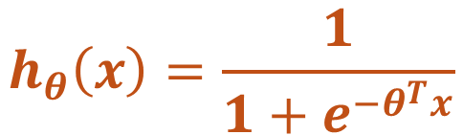
Cost function
Linear regression: $J\left(θ\right)=\frac{1}{m}\sum_{i=1}^{m}{\frac{1}{2}}{\left(h_{θ}\left(x^{\left(i\right)}\right)−\left(y^{\left(i\right)}\right)\right)}^{2}$
Cost$\left(h_{θ}\left(x\right),y \right) = \frac{1}{2}{\left(h_{θ}\left(x\right)−\left(y\right)\right)}^{2}$
$$h_{θ}\left(x\right)=\frac{1}{1+e^{−θ^{T}x}}$$
We are interested in finding the COST Function of Logistic Regression, which is “non-convex”

Slide 81
Cost function
Linear regression: $J\left(θ\right)=\frac{1}{m}\sum_{i=1}^{m}{\frac{1}{2}}{\left(h_{θ}\left(x^{\left(i\right)}\right)−\left(y^{\left(i\right)}\right)\right)}^{2}$
Cost$\left(h_{θ}\left(x\right),y \right) = \frac{1}{2}{\left(h_{θ}\left(x\right)−\left(y\right)\right)}^{2}$
Non-linear function
$$h_{θ}\left(x\right)=\frac{1}{1+e^{−θ^{T}x}}$$
We are interested in finding the COST Function of Logistic Regression, which is “non-convex”

Slide 82


Cost function
Linear regression: $J\left(θ\right)=\frac{1}{m}\sum_{i=1}^{m}{\frac{1}{2}}{\left(h_{θ}\left(x^{\left(i\right)}\right)−\left(y^{\left(i\right)}\right)\right)}^{2}$
Cost$\left(h_{θ}\left(x\right),y \right) = \frac{1}{2}{\left(h_{θ}\left(x\right)−\left(y\right)\right)}^{2}$
Non-linear function
$$h_{θ}\left(x\right)=\frac{1}{1+e^{−θ^{T}x}}$$
We are interested in finding the COST Function of Logistic Regression, which is “non-convex”

Slide 83
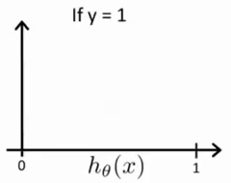
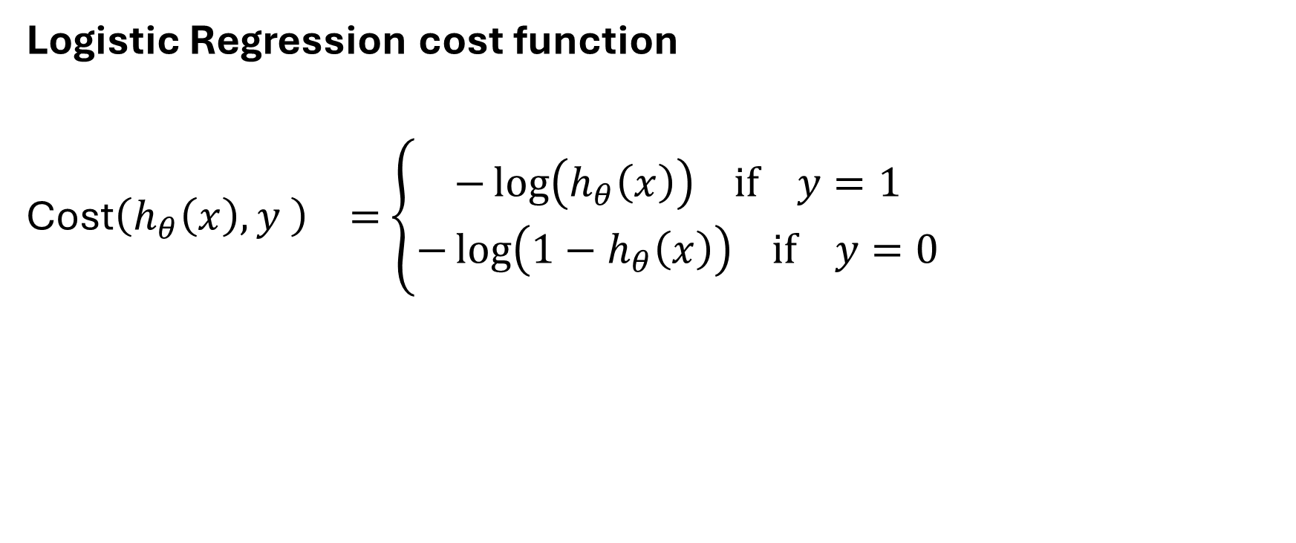
Logistic Regression cost function
Cost$\left(h_{θ}\left(x\right),y \right) =$ $\left\{\begin{aligned}−\log\left(h_{θ}\left(x\right)\right) if y=1 \\ −\log\left({1−h}_{θ}\left(x\right)\right) if y=0\end{aligned}\right.$

Slide 84

Logistic Regression cost function
Cost$\left(h_{θ}\left(x\right),y \right) =$ $\left\{\begin{aligned}−\log\left(h_{θ}\left(x\right)\right) if y=1 \\ −\log\left({1−h}_{θ}\left(x\right)\right) if y=0\end{aligned}\right.$

Slide 85
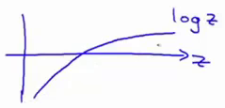
Logistic Regression cost function
Cost$\left(h_{θ}\left(x\right),y \right) =$ $\left\{\begin{aligned}−\log\left(h_{θ}\left(x\right)\right) if y=1 \\ −\log\left({1−h}_{θ}\left(x\right)\right) if y=0\end{aligned}\right.$

Slide 86

Logistic Regression cost function
Cost$\left(h_{θ}\left(x\right),y \right) =$ $\left\{\begin{aligned}−\log\left(h_{θ}\left(x\right)\right) if y=1 \\ −\log\left({1−h}_{θ}\left(x\right)\right) if y=0\end{aligned}\right.$

Slide 87
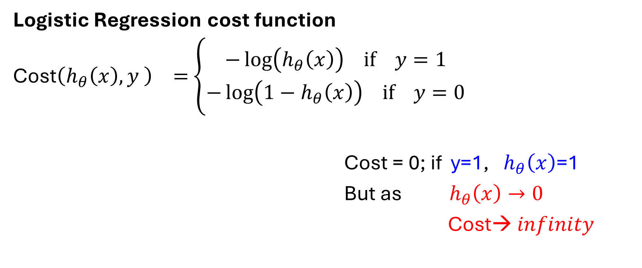
Logistic Regression cost function
Cost$\left(h_{θ}\left(x\right),y \right) =$ $\left\{\begin{aligned}−\log\left(h_{θ}\left(x\right)\right) if y=1 \\ −\log\left({1−h}_{θ}\left(x\right)\right) if y=0\end{aligned}\right.$
Cost = 0; if y=1, $h_{θ}\left(x\right)$=1
But as ${ h}_{θ}\left(x\right)→0$
Cost→ $infinity$

Slide 88
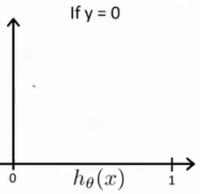
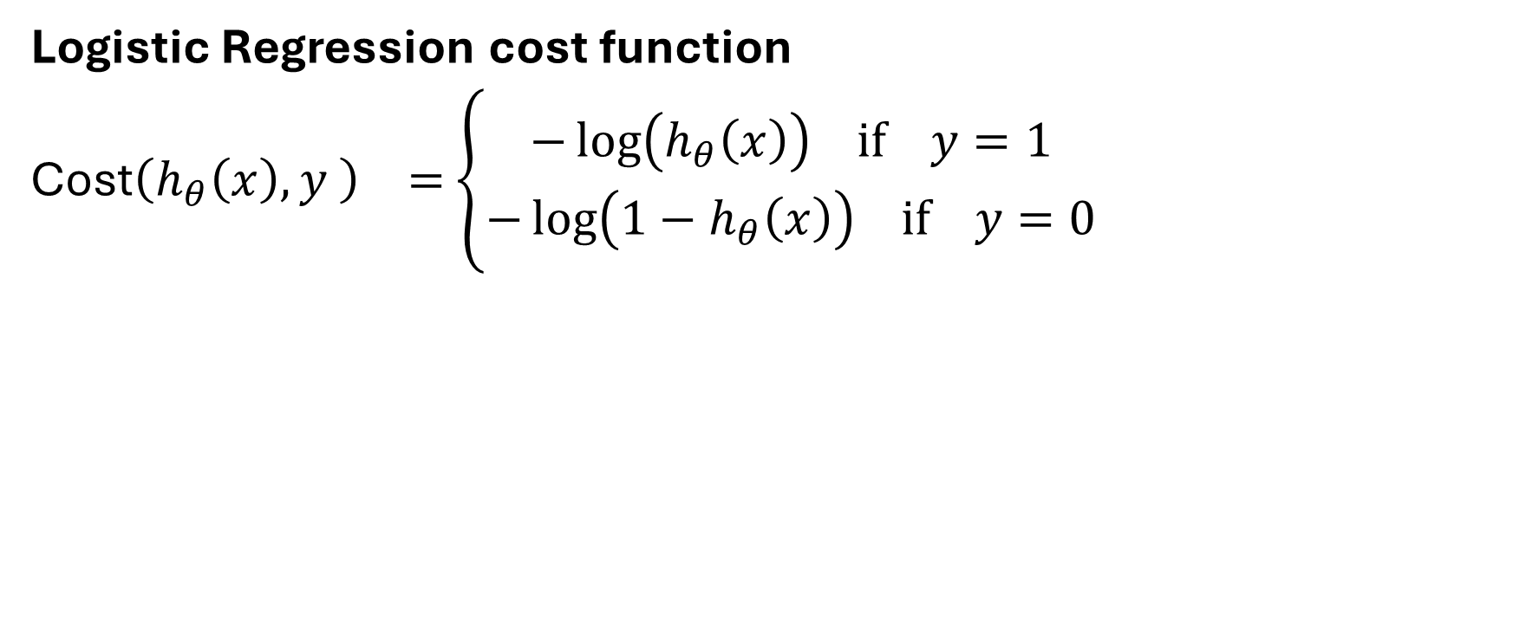
Logistic Regression cost function
Cost$\left(h_{θ}\left(x\right),y \right) =$ $\left\{\begin{aligned}−\log\left(h_{θ}\left(x\right)\right) if y=1 \\ −\log\left({1−h}_{θ}\left(x\right)\right) if y=0\end{aligned}\right.$

Slide 89

Logistic Regression cost function
Cost$\left(h_{θ}\left(x\right),y \right) =$ $\left\{\begin{aligned}−\log\left(h_{θ}\left(x\right)\right) if y=1 \\ −\log\left({1−h}_{θ}\left(x\right)\right) if y=0\end{aligned}\right.$

Slide 90

Logistic Regression cost function
Cost$\left(h_{θ}\left(x\right),y \right) =$ $\left\{\begin{aligned}−\log\left(h_{θ}\left(x\right)\right) if y=1 \\ −\log\left({1−h}_{θ}\left(x\right)\right) if y=0\end{aligned}\right.$

Slide 91
Logistic Regression
Simplified cost function and
gradient descent

Slide 92

Logistic regression cost function
Note: y = 0 or 1 always
$J\left(θ\right)=\frac{1}{m}\sum_{i=1}^{m}{Cost\left(h_{θ}\left(x^{\left(i\right)}\right)−\left(y^{\left(i\right)}\right)\right)}$
Cost$\left(h_{θ}\left(x\right),y \right) =$ $\left\{\begin{aligned}−\log\left(h_{θ}\left(x\right)\right) if y=1 \\ −\log\left({1−h}_{θ}\left(x\right)\right) if y=0\end{aligned}\right.$

Slide 93
Logistic regression cost function
Note: y = 0 or 1 always
$J\left(θ\right)=\frac{1}{m}\sum_{i=1}^{m}{Cost\left(h_{θ}\left(x^{\left(i\right)}\right)−\left(y^{\left(i\right)}\right)\right)}$
Cost$\left(h_{θ}\left(x\right),y \right) =$ $\left\{\begin{aligned}−\log\left(h_{θ}\left(x\right)\right) if y=1 \\ −\log\left({1−h}_{θ}\left(x\right)\right) if y=0\end{aligned}\right.$
Cost$\left(h_{θ}\left(x\right),y \right) =$ $−\operatorname{ylog}\left(h_{θ}\left(x\right)\right) − (1− y)\log\left({1−h}_{θ}\left(x\right)\right)$

Slide 94

Logistic regression cost function
Note: y = 0 or 1 always
If y = 1: Cost$\left(h_{θ}\left(x\right),y \right)$ = $−\log\left(h_{θ}\left(x\right)\right)$
$J\left(θ\right)=\frac{1}{m}\sum_{i=1}^{m}{Cost\left(h_{θ}\left(x^{\left(i\right)}\right)−\left(y^{\left(i\right)}\right)\right)}$
Cost$\left(h_{θ}\left(x\right),y \right) =$ $\left\{\begin{aligned}−\log\left(h_{θ}\left(x\right)\right) if y=1 \\ −\log\left({1−h}_{θ}\left(x\right)\right) if y=0\end{aligned}\right.$
Cost$\left(h_{θ}\left(x\right),y \right) =$ $−\operatorname{ylog}\left(h_{θ}\left(x\right)\right) − (1− y)\log\left({1−h}_{θ}\left(x\right)\right)$

Slide 95

Logistic regression cost function
Note: y = 0 or 1 always
If y = 1: Cost$\left(h_{θ}\left(x\right),y \right)$ = $−\log\left(h_{θ}\left(x\right)\right)$
If y = 0: Cost$\left(h_{θ}\left(x\right),y \right)$ = $−\log\left(1−h_{θ}\left(x\right)\right)$
$J\left(θ\right)=\frac{1}{m}\sum_{i=1}^{m}{Cost\left(h_{θ}\left(x^{\left(i\right)}\right)−\left(y^{\left(i\right)}\right)\right)}$
Cost$\left(h_{θ}\left(x\right),y \right) =$ $\left\{\begin{aligned}−\log\left(h_{θ}\left(x\right)\right) if y=1 \\ −\log\left({1−h}_{θ}\left(x\right)\right) if y=0\end{aligned}\right.$
Cost$\left(h_{θ}\left(x\right),y \right) =$ $−\operatorname{ylog}\left(h_{θ}\left(x\right)\right) − (1− y)\log\left({1−h}_{θ}\left(x\right)\right)$

Slide 96

Logistic regression cost function
$J\left(θ\right)=\frac{1}{m}\sum_{i=1}^{m}{Cost\left(h_{θ}\left(x^{\left(i\right)}\right)−\left(y^{\left(i\right)}\right)\right)}$
$=−\frac{1}{m}[\sum_{i=1}^{m}{y^{(i)}\log\left(h_{θ}\left(x^{(i)}\right)\right)+(1− y^{(i)})\log\left({1−h}_{θ}\left(x^{(i)}\right)\right)] }$

Slide 97


Logistic regression cost function
To fit parameters (Theta):
$$\min_{θ}{J(θ)}$$
To make a prediction given new $x$:
Output:
$J\left(θ\right)=\frac{1}{m}\sum_{i=1}^{m}{Cost\left(h_{θ}\left(x^{\left(i\right)}\right)−\left(y^{\left(i\right)}\right)\right)}$
$=−\frac{1}{m}[\sum_{i=1}^{m}{y^{(i)}\log\left(h_{θ}\left(x^{(i)}\right)\right)+(1− y^{(i)})\log\left({1−h}_{θ}\left(x^{(i)}\right)\right)] }$
$$h_{θ}\left(x\right)=\frac{1}{1+e^{−θ^{T}x}}$$

Slide 98


Gradient Descent
Want $\min_{θ}{J\left(θ\right)}$:
Repeat{
$θ_{j}≔ θ_{j}−α\frac{∂}{∂θ_{j}}J(θ)$
(simultaneously update all $θ_{j}$)
}
$$J\left(θ\right) =−\frac{1}{m}[\sum_{i=1}^{m}{y^{(i)}\log\left(h_{θ}\left(x^{(i)}\right)\right)+(1− y^{(i)})\log\left({1−h}_{θ}\left(x^{(i)}\right)\right)] }$$

Slide 99
Gradient Descent
Want $\min_{θ}{J\left(θ\right)}$:
Repeat{
$θ_{j}≔ θ_{j}−α\frac{∂}{∂θ_{j}}J(θ)$
(simultaneously update all $θ_{j}$)
}
$$J\left(θ\right) =−\frac{1}{m}[\sum_{i=1}^{m}{y^{(i)}\log\left(h_{θ}\left(x^{(i)}\right)\right)+(1− y^{(i)})\log\left({1−h}_{θ}\left(x^{(i)}\right)\right)] }$$

Slide 100

Gradient Descent
Want $\min_{θ}{J\left(θ\right)}$:
Repeat{
$θ_{j}≔ θ_{j}−α\sum_{i=1}^{m}{(h_{θ}\left(x^{\left(i\right)}\right)−y^{(i)})x_{j}^{(i)}}$
(simultaneously update all $θ_{j}$)
}
$$J\left(θ\right) =−\frac{1}{m}[\sum_{i=1}^{m}{y^{(i)}\log\left(h_{θ}\left(x^{(i)}\right)\right)+(1− y^{(i)})\log\left({1−h}_{θ}\left(x^{(i)}\right)\right)] }$$

Slide 101

Gradient Descent
Want $\min_{θ}{J\left(θ\right)}$:
Repeat{
$θ_{j}≔ θ_{j}−α\sum_{i=1}^{m}{(h_{θ}\left(x^{\left(i\right)}\right)−y^{(i)})x_{j}^{(i)}}$
(simultaneously update all $θ_{j}$)
}
Looks identical to linear regression!!!
$$J\left(θ\right) =−\frac{1}{m}[\sum_{i=1}^{m}{y^{(i)}\log\left(h_{θ}\left(x^{(i)}\right)\right)+(1− y^{(i)})\log\left({1−h}_{θ}\left(x^{(i)}\right)\right)] }$$

Slide 102




Gradient Descent
Want $\min_{θ}{J\left(θ\right)}$:
Repeat{
$θ_{j}≔ θ_{j}−α\sum_{i=1}^{m}{(h_{θ}\left(x^{\left(i\right)}\right)−y^{(i)})x_{j}^{(i)}}$
(simultaneously update all $θ_{j}$)
}
Looks identical to linear regression!!!
$$J\left(θ\right) =−\frac{1}{m}[\sum_{i=1}^{m}{y^{(i)}\log\left(h_{θ}\left(x^{(i)}\right)\right)+(1− y^{(i)})\log\left({1−h}_{θ}\left(x^{(i)}\right)\right)] }$$

